Slide 1
Support Vector Machines
Slides adapted from Ray Mooney, David Kauchak, and Andrew Moore
TexPoint fonts used in EMF.
Read the TexPoint manual before you delete this box.: 

Slide 2
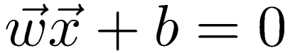
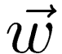
Recall: Linear Classifiers
Points on a hyperplane satisfy
where is the normal to the hyperplane
w^{T}x + b = 0
w^{T}x + b > 0
w^{T}x + b < 0
f(x) = sign(w^{T}x + b)

Slide 3
Linear Separators
Which of these linear separators would PLA or Pocket Algorithm give?
Which of these linear separators is the “best”? Why?

Slide 4
Noise in the Observations
O
X
O
X
O
X
X
O
O
X
O
X
X
O
O
X

Slide 5
Separators in the Case of Noisy Data
O
X
O
X
O
X
X
O
O
X
O
X
X
O
O
X

Slide 6
Separators in the Case of Very Noisy Data
O
X
O
X
O
X
X
O
O
X
O
X
X
O
O
X

Slide 7
Classification Margin
Distance from example x_{i} to the separator is
Examples closest to the hyperplane are support vectors
Margin ρ of the separator is the distance between support vectors
Maximizing the margin is good
both according to intuition and theory
Implies that only support vectors matter
ρ
r

Slide 8
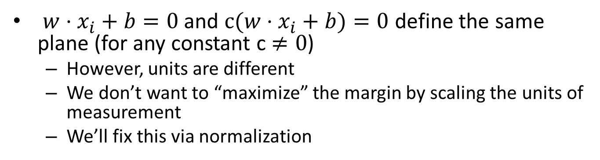
Units for Distance?
$w⋅x_{i}+b=0$ and $c(w⋅x_{i}+b)=0$ define the same plane (for any constant c $≠0$)
However, units are different
We don’t want to “maximize” the margin by scaling the units of measurement
We’ll fix this via normalization

Slide 9
Margin Lines
Let’s define the equations of the margin lines to be$w⋅x_{i}+b=±1$

Slide 10
Support Vector Distance & Margin

Slide 11
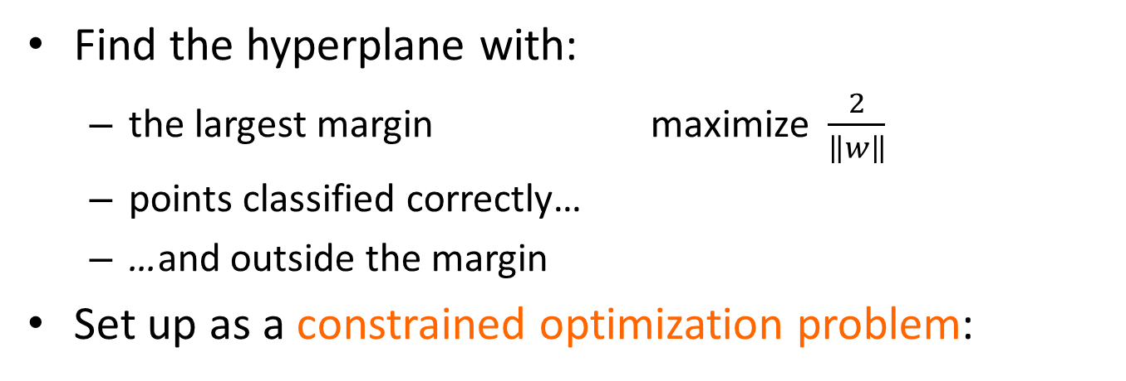
Max-Margin Classification
Find the hyperplane with:
the largest margin maximize $\frac{2}{\left\|w\right\|}$
points classified correctly…
…and outside the margin
Set up as a constrained optimization problem:
+1/-1 “trick”
subject to:
Notes:
All points are classified correctly AND they have a prediction >= 1.

Slide 12
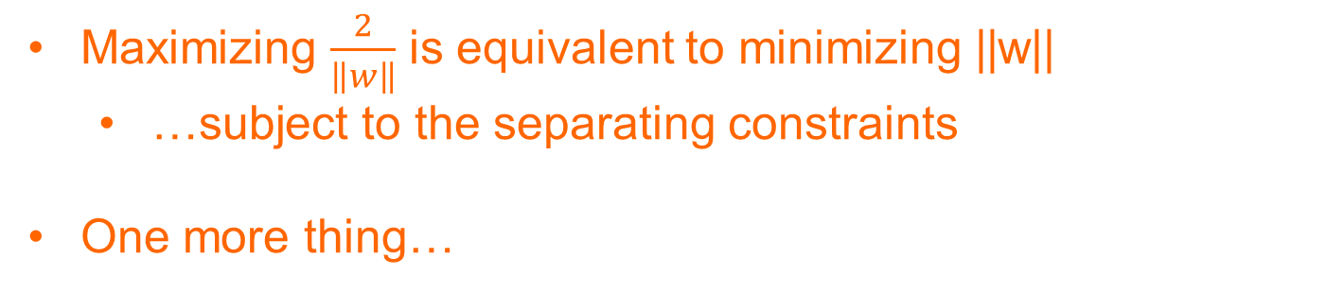
Maximizing the margin
subject to:
Maximizing $\frac{2}{\left\|w\right\|}$ is equivalent to minimizing ||w||
…subject to the separating constraints
One more thing…

Slide 13
Maximizing the margin
subject to:
Why the squared?

Slide 14
Maximizing the margin
subject to:
subject to:
Minimizing ||w|| is equivalent to minimizing ||w||²
The sum of the squared weights is a convex function!

Slide 15
SVM Optimization
subject to:
This is quadratic optimization problem subject to linear constraints
*Many* ways to solve these types of problems
We’ll come back to solving these later…
For the moment, we’ll just assume solving is possible…

Slide 16
What do we have so far?
Previous Linear Methods
SVM (so far…)
Linear classifiers
Does not require linear separability
Minimizes surrogate loss + regularization
Solver: Gradient Descent
Linear classifier
Requires linear separability
Maximizes margin
Solver: ???
Benefit of SVM is not yet obvious…

Slide 17
Soft Margin Classification
What if the training set is not linearly separable?
Slack variables ξi can be added to allow misclassification of difficult or noisy examples, resulting margin called soft
ξ_{i}
ξ_{i}

Slide 18
Soft Margin Classification
The old (hard margin) formulation:
Modified formulation incorporates slack variables:
What is the purpose of parameter C?
Trade-off between margin maximization and penalization
Also related to overfitting…
Find w and b such that
Φ(w) =w^{T}w is minimized
and for all (x_{i} ,y_{i}), i=1..n : y_{i} (w^{T}x_{i} + b) ≥ 1
Find w and b such that
Φ(w) =w^{T}w + CΣξ_{i} is minimized
and for all (x_{i} ,y_{i}), i=1..n : y_{i} (w^{T}x_{i} + b) ≥ 1 – ξ_{i,} , ξ_{i} ≥ 0
Still a quadratric optimization problem with linear constraints!

Slide 19
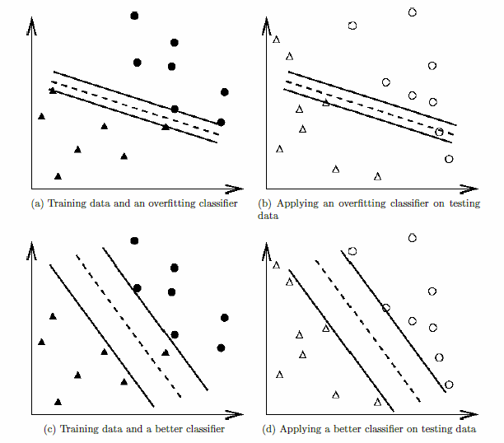
Overfitting
Slack parameter helps avoid overfitting

Slide 20
What do we have so far?
Previous Linear Methods
SVM (so far…)
Linear classifiers
Does not require linear separability
Minimizes surrogate loss + regularization
Solver: Gradient Descent
Linear classifier
Does not require linear separability
Maximizes margin
Solver: ???
Getting better… Maybe some information on the solver will help…

Slide 21
Slack & Soft Margin SVM
subject to:
What are the slack values for points outside (or on) the margin AND correctly classified?

Slide 22
Slack & Soft Margin SVM
subject to:
0! Slack variables have to be >= 0 and if they’re on or beyond the margin then y_{i}(wx_{i}+b) ≥ 1 already

Slide 23
Slack & Soft Margin SVM
subject to:
What are the slack values for points inside the margin AND classified correctly?

Slide 24
Slack & Soft Margin SVM
subject to:
Difference from the point to the margin.

Slide 25
Slack & Soft Margin SVM
subject to:
What are the slack values for points that are incorrectly classified?

Slide 26
Slack & Soft Margin SVM
subject to:
“distance” to the hyperplane plus the “distance” to the margin

Slide 27
Slack & Soft Margin SVM
subject to:

Slide 28
Slack & Soft Margin SVM
Does this look familiar?

Slide 29
Hinge loss!
0/1 loss:
Hinge:
Exponential:
Squared loss:

Slide 30
Unconstrained Optimization (Bonus #2!)
subject to:
Do we need the constraints still?
Unconstrained problem!

Slide 31
SVM Solver #1: Gradient Descent
multiply through by 1/C
and rearrange
let λ=1/C
hinge loss
L2 regularization

Slide 32
What do we have so far?
Previous Linear Methods
SVM (so far…)
Linear classifiers
Does not require linear separability
Minimizes surrogate loss + regularization
Solver: Gradient Descent
Linear classifier
Does not require linear separability
Maximizes margin
Solver: Gradient Descent
Let’s explore another approach to solving SVMs…

Slide 33
Constrained Quadratic Optimization
Find w and b such that
Φ(w) =w^{T}w + CΣξ_{i} is minimized
and for all (x_{i} ,y_{i}), i=1..n : y_{i} (w^{T}x_{i} + b) ≥ 1 – ξ_{i,} , ξ_{i} ≥ 0
Need to optimize a quadratic function subject to linear constraints.
Several (non-trivial) algorithms exist for this
One approach transforms the original (primal) problem into its dual form
Variables become constraints
Constraints become variables

Slide 34
SVM Solver #2: Constrained Quadratic Optimization
Primal
Find w and b such that
Φ(w) =w^{T}w + CΣξ_{i} is minimized
and for all (x_{i} ,y_{i}), i=1..n : y_{i} (w^{T}x_{i} + b) ≥ 1 – ξ_{i,} , ξ_{i} ≥ 0
The solution involves constructing a dual problem where a Lagrange multiplier α_{i} is associated with every inequality constraint in the primal problem:
Dual
Find α₁…α_{n} such that
Q(α) =Σα_{i} - ½ΣΣα_{i}α_{j}y_{i}y_{j}x_{i}^{T}x_{j} is maximized and
(1) Σα_{i}y_{i} = 0
(2) α_{i} ≥ 0 for all α_{i}

Slide 35
SVM Classification
Given a solution α₁…α_{n} to the dual problem, we can recover w and b:
However, we can formulate classifier with dual variables:
Non-zero α_{i} indicates that corresponding x_{i} is a support vector
w =Σα_{i}y_{i}x_{i} b = y_{k} - Σα_{i}y_{i}x_{i} ^{T}x_{k} for any α_{k} > 0
f(x) = Σα_{i}y_{i}x_{i}^{T}x + b

Slide 36
SVM Recap
Most “important” training points are support vectors; they define the hyperplane
Optimization algorithms identify support vectors
non-zero LaGrangian multipliers αi.
Observation: Both in the dual formulation of the problem and in the solution training points appear only inside inner products:
Find α₁…α_{N} such that
Q(α) =Σα_{i} - ½ΣΣα_{i}α_{j}y_{i}y_{j}x_{i}^{T}x_{j} is maximized and
(1) Σα_{i}y_{i} = 0
(2) 0 ≤ α_{i} ≤ C for all α_{i}
f(x) = Σα_{i}y_{i}x_{i}^{T}x + b

Slide 37
Nonlinear SVMs
Datasets that are linearly separable with some noise work out great:
But what are we going to do if the dataset is just too hard?
How about mapping data to a higher-dimensional space:
0
x
0
x
x²
0
x

Slide 38
Nonlinear SVMs: Feature Spaces
Idea: The original feature space can be mapped to some higher-dimensional feature space where the training set is separable
Is this always true?
Φ: x → φ(x)

Slide 39
The “Kernel Trick”
Note: SVMs rely on the inner product between vectors K(x_{i},x_{j})=x_{i}^{T}x_{j}
If every data point is mapped into high-dimensional space via some transformation Φ: x → φ(x), the inner product becomes:
K(x_{i},x_{j})= φ(x_{i}) ^{T}φ(x_{j})
A kernel function is a type of function that is equivalent to an inner product in some feature space
So, how do we known if a given function is a kernel function?

Slide 40
Kernel Example
Example: Input feature is 2D: x=[x₁ x₂]
K(x_{i},x_{j})=(1 + x_{i}^{T}x_{j})²
Is K a kernel function?
We need to show that K(x_{i},x_{j})= φ(x_{i}) ^{T}φ(x_{j})
For some mapping function, φ(x_{i})
K(x_{i},x_{j})=(1 + x_{i}^{T}x_{j})², = 1+ x_{i1}²x_{j1}² + 2 x_{i1}x_{j1} x_{i2}x_{j2}+ x_{i2}²x_{j2}² + 2x_{i1}x_{j1} + 2x_{i2}x_{j2}
= [1 x_{i1}² √2 x_{i1}x_{i2} x_{i2}² √2x_{i1} √2x_{i2}]^{T} [1 x_{j1}² √2 x_{j1}x_{j2} x_{j2}² √2x_{j1} √2x_{j2}]
= φ(x_{i}) ^{T}φ(x_{j}), where φ(x) = [1 x₁² √2 x₁x₂ x₂² √2x₁ √2x₂]
So, this function implicitly maps 2D data to a 6D space and takes the inner product
Do we have to do this for every function to check if it is a kernel function?

Slide 41
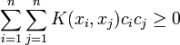
What Functions are Kernels?
Checking that K(x_{i},x_{j})= φ(x_{i}) ^{T}φ(x_{j}) can be impossible
Fortunately, there is an easier way to find kernels…
Mercer’s theorem: Every positive semidefinite symmetric function is a kernel function
Checking these conditions is much easier than what we did on the previous slide
We don’t have to know where the points map to!
K(a, b) = K(b, a)

Slide 42
Common Kernel Functions
Linear: K(x_{i},x_{j})= x_{i}^{T}x_{j}
Mapping Φ: x → φ(x), where φ(x) is x itself
Polynomial of power p: K(x_{i},x_{j})= (1+ x_{i}^{T}x_{j})^{p}
Mapping Φ: x → φ(x), where φ(x) has dimensions
Gaussian (radial-basis function): K(x_{i},x_{j}) =
Mapping Φ: x → φ(x), where φ(x) is infinite-dimensional: every point is mapped to a function (a Gaussian)
Linear separators in higher dimensional space correspond to nonlinear separators in original space

Slide 44
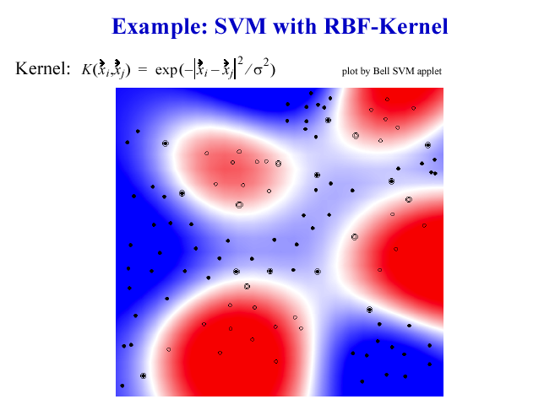

Slide 45
Custom Kernels
Previous examples mapped real-valued vectors to (higher-dimensional) real-valued vectors
Input does not need to be real-valued vectors
For SVM, all we need is a function that computes the similarity of two features
This function is the kernel function

Slide 46
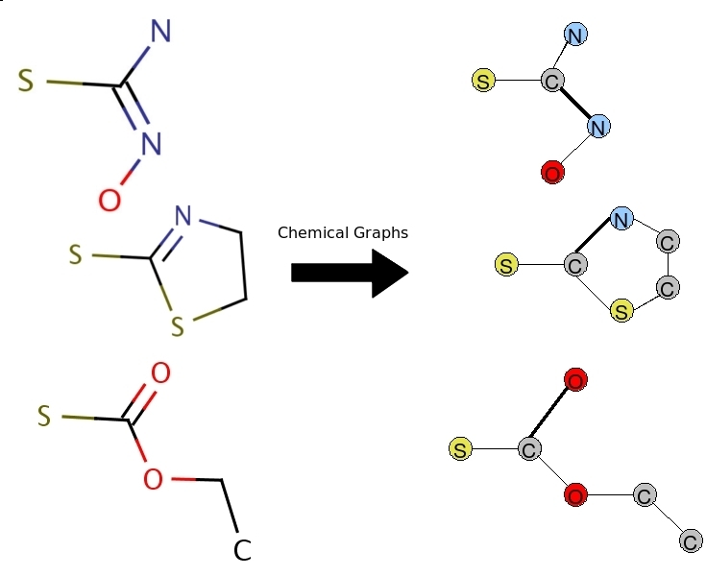
Example Custom Kernel
Drug screening
Consider chemicals as graphs
Graphs maintain rich structure of chemical model
Better than feature vector
Need a similarity function between graphs

Slide 47
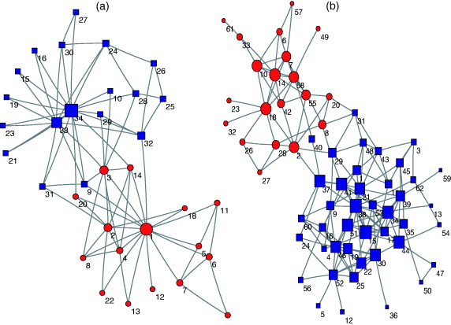
Graph Kernels
Graph Edit Similarity
Related to Graph Edit Distance
Measures the # operations needed to transform one graph to another
Insert/delete/change vertex
Insert/delete/change edge
In general graph edit is NP-hard
Many approximation algorithms
E.g., random walk kernel

Slide 48
Graph Kernel (cont’d)
For classification, each of these chemicals/graphs would have an associated label (“safe” / “not safe”)
Training:
For each pair of examples, compute similarity
PSD function that gives similarity between two graphs *is* a kernel function
Testing:
For new example, compute similarity to each graph that is a support vector
Note: No feature vectors!
A
B
C
 | A | B | C
A | 1 | .6 | .3
B | .6 | 1 | .2
C | .3 | .2 | 1
This table (called kernel matrix) represents the pairwise kernel values of the data. These values can be used as input to train an SVM

Slide 49
Nonlinear SVMs Mathematically
Dual problem formulation:
The solution is:
Optimization techniques for finding αi’s remain the same!
Find α₁…α_{n} such that
Q(α) =Σα_{i} - ½ΣΣα_{i}α_{j}y_{i}y_{j}K(x_{i}, x_{j}) is maximized and
(1) Σα_{i}y_{i} = 0
(2) α_{i} ≥ 0 for all α_{i}
Only change (from linear version) is replacing inner product of vectors with kernel function
f(x) = Σα_{i}y_{i}K(x_{i}, x_{j})+ b

Slide 50
What do we have so far?
Previous Linear Methods
SVM
Linear classifiers
Does not require linear separability
Minimizes surrogate loss + regularization
Solver: Gradient Descent
Kernel (nonlinear) classifier
Does not require (linear) separability
Maximizes margin
Solver: Gradient Descent and many QP algorithms
Now the benefits of SVM are clear!

Slide 51
Practical SVM
Most beginners use the following procedure:
Transform data to the format of an SVM package
Randomly try a few kernels and parameters
Test
Better option:
Transform data to the format of an SVM package
Scale your data
Consider the RBF kernel
Use cross-validation to find the best parameters
C: slack penalty
σ (or γ): kernel bandwidth
Use the best parameters to train the whole training set
Test
From “A Practical Guide to Support Vector Classification” by Chih-Wei Hsu, Chih-Chung Chang, and Chih-Jen Lin (creators of libsvm)

Slide 52
Strengths of SVMs
Good generalization in theory
Good generalization in practice
Work well with few training instances
Efficient algorithms
Amenable to the “kernel trick”
Many full-featured implementations
LibSVM (Python, C++, Matlab, Java), LibLinear, SVMLight, Weka, Shogun

Slide 53
About SVM
Originally proposed by Boser, Guyon and Vapnik in 1992
Increasing popularity in late 1990s
Used for classification tasks ranging from text to genomic data
Can be applied to complex data types beyond feature vectors
e.g. graphs, sequences, relational data
Custom kernel functions
More than classification:
Regression [Vapnik et al. ’97]
Principal component analysis [Schölkopf et al. ’99]
Clustering [Vapnik et al. ‘01]
Tuning SVMs is more art than science
Selecting a specific kernel and parameters is usually done in a try-and-see manner.

